Slide 1
SpringBoard 10th
Activity 1.3
Exploring Cultural Identity

Slide 2
Learning Targets
Compare and contrast how a theme or central idea of a text is developed in a academic and literary nonfiction text

Slide 3
Do Now
What does this photo show?
Describe it and explain what you think it means.

Slide 4
Reading Informational Texts (Groups of 4)
“What is Cultural Identity?” p 8 to 10
Group 1- Victor, Tory, Ariana, Natasha
Group 2- Jefferson, Drequan, Arnaldo, Martin
Group 3- Breana, Jaziah, Naomi, Danny
Group 4- Malik, Roneyba, Luis, Ayda

Slide 5
Assign Group Roles
Recorder
Keeps notes on important thoughts expressed in the group
Keeps all materials for the group in order
Facilitator
Makes certain that everyone contributes
Leads the group through discussions by following agenda
Time Keeper
Keeps track of time
Keeps the group on task
Speaks for the group when needed
Researcher
Works on the computer
Looks for and finds missing information
Gathers materials needed- such as paper, pencils, pens and markers

Slide 6
What to mark?
Voice (1/2 group)
As you read, identify (circle) places –words, phrases- where one author is using an ACADEMIC VOICE, and the other is using a INFORMAL VOICE
Cultural Identity (1/2 group)
As you read, identify (underline) information that helps to define cultural identity

Slide 7
When your group is done…
Together, Summarize your section of the text
How does your section contribute to the definition of Cultural Identity?
Answer the Key Ideas and Details Questions in the margins
Be prepared to share out!

Slide 8
After Reading (individually answer in text)
What is your understanding of cultural identity based on this text?
Reflect on invisible aspects of your culture. What differences exist between you and your culture?
What are some examples of your culture? Explain how these aspects are dynamic

Slide 9
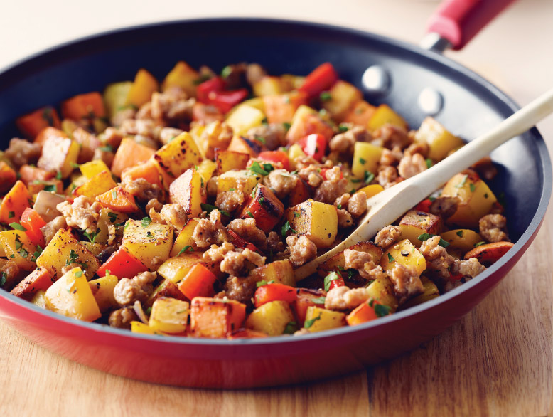
Exit Slip
What is HASH, as pictured above?

Slide 10
Activity 1.3 - Day 2

Slide 11
Learning Targets
Compare and contrast how a theme or central idea of a text is developed in a academic and literary nonfiction text

Slide 12
“Ethnic Hash”
DO NOW:
What do you think the title suggests about what this article will be about?

Slide 13
Reading Informational Texts (Groups of 4)
“Ethnic Hash” p 11 to 12
Group 1- Victor, Tory, Ariana, Natasha
Group 2- Jefferson, Drequan, Arnaldo, Martin
Group 3- Breana, Jaziah, Naomi, Danny
Group 4- Malik, Roneyba, Luis, Ayda

Slide 14
What to look for
First Person Point of View
Punctuation to create humor
Fragments for Effect
Shifts in Tone (eg. Funny to serious)
Vivid details and descriptions

Slide 15
Group work reading assignments
Par. 3-4 “Ethnic recipes… He uses lard.”
Par. 5-6 “My mother’s family… never be dull.”
Par. 7-8 “The Truth is… such a meal…”
Par. 9-10 “Some have said… Coffee! Tea!”
When done, be prepared to share out

Slide 16
After Reading Jig Saw groups
Answer questions 8-11 in your jig saw groups

Slide 17
Quick Write
Choose a characteristic of culture and use it to explain your cultural identity. Be sure to:
Use an informal voice to engage your audience.
Develop your response with vivid details and descriptions.
Use diction and punctuation to create an appropriate tone.
MUST BE 8-12 sentences minimum
Hand in, or take home and finish for hw

